Slide 1
Joins in SQL

Slide 2
Joins & Types
A SQL JOIN combines records from two tables
A JOIN locates related column values in the two tables
A query can contain zero, one, or multiple JOIN operations
INNER JOIN is the same as JOIN; the keyword INNER is optional
Syntax :-
SELECT column-names FROM table-name1 JOIN table-name2 ON column-name1 = column-name2 WHERE condition

Slide 3
Types of Join
Inner Join
Full(Outer) Join
Left(Outer) Join
Right(Outer) Join

Slide 4
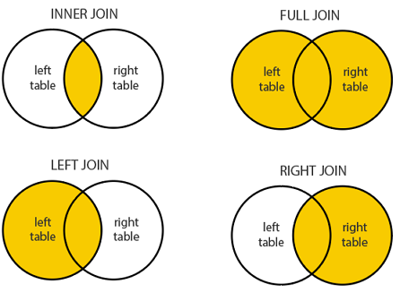
Types of Join
1. INNER JOIN: Select records that have matching values in both tables.
2. FULL (OUTER) JOIN: Selects all records that match either left or right table records.

Slide 5
Contd…
3. LEFT (OUTER) JOIN: Select records from the first (left-most) table with matching right table records.
4. RIGHT (OUTER) JOIN: Select records from the second (right-most) table with matching left table records.

Slide 6
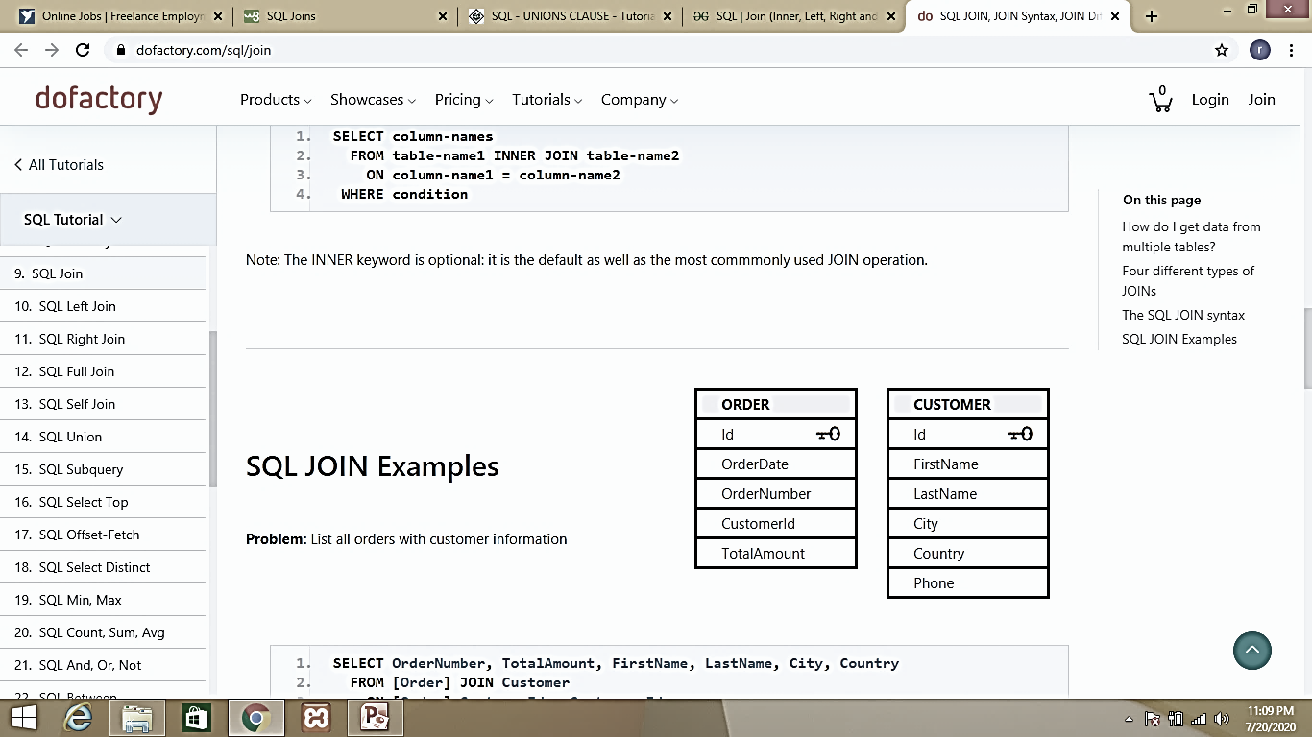
SQL JOIN Examples
List all orders with customer information
SELECT OrderNumber, TotalAmount, FirstName, LastName, City, Country FROM [Order] JOIN Customer ON [Order].CustomerId = Customer.Id
OrderNumber | TotalAmount | FirstName | LastName | City | Country
124237 | 240.00 | Paul | Sens | Reims | France
124237 | 863.40 | Karina | Martin | Münster | Germany
124238 | 113.00 | Marid | Kem | Rio de Janeiro | Brazil

Slide 7
SQL LEFT JOIN Example
List all customers and the total amount they spent irrespective whether they placed any orders or not.
SELECT OrderNumber, TotalAmount, FirstName, LastName, City, Country FROM Customer C LEFT JOIN [Order] O ON O.CustomerId = C.Id
OrderNumber | TotalAmount | FirstName | LastName | City | Country
542716 | 28.00 | Maurizio | Moroni | Reggio Emilia | Italy
543028 | 30.00 | Yvonne | Moncada | Buenos Aires | Argentina
543013 | 36.00 | Fran | Wilson | Portland | USA

Slide 8
SQL RIGHT JOIN Example
List customers that have not placed orders
SELECT FirstName, LastName, City, Country FROM [Order] O RIGHT JOIN Customer C ON O.CustomerId = C.Id WHERE TotalAmount IS NULL
FirstName | LastName | City | Country
Diego | Roel | Madrid | Spain
Marie | Bertrand | Paris | France

Slide 9
SQL FULL JOIN Example
Match all customers and suppliers by country
SELECT C.FirstName, C.LastName, C.Country AS CustomerCountry, S.Country AS SupplierCountry, S.CompanyName FROM Customer C FULL JOIN Supplier S ON C.Country = S.Country;
FirstName | LastName | CustomerCountry | SupplierCountry | CompanyName
NULL | NULL | NULL | Australia | Pavlova, Ltd.
NULL | NULL | NULL | Australia | G'day, Mate
NULL | NULL | NULL | Japan | Tokyo Traders
NULL | NULL | NULL | Japan | Mayumi's
Yvonne | Moncada | Argentina | NULL | NULL
Sergio | Gutiérrez | Argentina | NULL | NULL
Georg | Pipps | Austria | NULL | NULL
Roland | Mendel | Austria | NULL | NULL

Slide 10
Self Join
A self JOIN is a regular join but the table is joined with itself
This can be useful when modeling hierarchies
They are also useful for comparisons within a table
Match customers that are from the same city and country
SELECT B.FirstName AS FirstName1, B.LastName AS LastName1, A.FirstName AS FirstName2, A.LastName AS LastName2,
B.City, B.Country FROM Customer A JOIN Customer B
ON A.Id <> B.Id AND A.City = B.City AND A.Country = B.Country

Slide 11
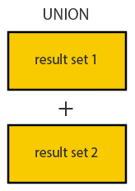
UNION Operator
UNION combines the result sets of two queries
Column data types in the two queries must match
UNION combines by column position rather than column name
SELECT column-names1 FROM table-name1
UNION
SELECT column-names2 FROM table-name2

Slide 12
Union Example
List all companies, including suppliers and customers
SELECT 'Customer' As Type, FirstName + ' ' + LastName AS ContactName,
City, Country FROM Customer
UNION
SELECT 'Supplier', ContactName, City, Country FROM Supplier
Type | ContactName | City | Country
Customer | Alejandra Camino | Madrid | Spain
Customer | Alexander Feuer | Leipzig | Germany
Customer | Ana Trujillo | México D.F. | Mexico
Supplier | Beate Vileid | Sandvika | Norway
Supplier | Carlos Diaz | Sao Paulo | Brazil

Slide 13
Thank you

